Slide 1
Data Models
Lecture 2

Slide 2
Data Model
A data model provides a mechanism to structure the data for the entities being modeled, allows a set of manipulative mechanism to define them and enforce a set of constraints to ensure the accuracy of data
or
Conceptual model for structuring data

Slide 3
Types of Data Model
Network Model
Hierarchical Model
Relational Model
Object-oriented Data Models
Object-Relational Models

Slide 4
Network Model
  The first network DBMS was implemented by Honeywell in 1964-65 (IDS System).
  Adopted heavily due to the support by CODASYL (Conference on Data Systems Languages) (CODASYL - DBTG report of 1971).
  Later implemented in a large variety of systems - IDMS (Cullinet - now Computer Associates), DMS 1100 (Unisys), IMAGE (H.P. (Hewlett-Packard)), VAX -DBMS (Digital Equipment Corp., next COMPAQ, now H.P.).

Slide 5
Student
Course
Course offering
Is_A
Has_A
Section
Prerequisite
Student_Grades
Grade Reports
Grade Reports

Slide 6
Advantage and Limitations
Advantages
  Network Model is able to model complex relationships and represents semantics of add/delete on the relationships.
  Can handle most situations for modeling using record types and relationship types.
  Language is navigational; uses constructs like FIND, FIND member, FIND owner, FIND NEXT within set, GET, etc.
Limitations
  Navigational and procedural nature of processing
  Database contains a complex array of pointers that thread through a set of records.

Slide 7
Hierarchical Data Model
  Initially implemented in a joint effort by IBM and North American Rockwell around 1965
  Resulted in the IMS family of systems
  IBM’s IMS product had (and still has) a very large customer base worldwide
  Hierarchical model was formalized based on the IMS system
  Other systems based on this model: System 2k (SAS inc.)

Slide 8
Advantages and Limitations
Advantages:
  Simple to construct and operate
  Corresponds to a number of natural hierarchically organized domains, e.g., organization (“org”) chart
  Language is simple:
    Uses constructs like GET, GET UNIQUE, GET NEXT, GET NEXT WITHIN PARENT, etc.
Limitations:
  Navigational and procedural nature of processing
  Database is visualized as a linear arrangement of records
  Little scope for "query optimization"

Slide 9
Relational Data Model
Relational Model:
  Proposed in 1970 by E.F. Codd (IBM), first commercial system in 1981-82
  Now in several commercial products (e.g. DB2, ORACLE, MS SQL Server, SYBASE, INFORMIX)
  Several free open source implementations, e.g. MySQL, PostgreSQL
  Currently most dominant for developing database applications.

Slide 10
Object-oriented Data Models
Object-oriented Data Models:
  Several models have been proposed for implementing in a database system
  One set comprises models of persistent O-O Programming Languages such as C++ (e.g., in OBJECTSTORE or VERSANT), and Smalltalk (e.g., in GEMSTONE)
  Additionally, systems like O2, ORION (at MCC - then ITASCA), IRIS (at H.P.- used in Open OODB)
  Object Database Standard: ODMG-93, ODMG-version 2.0, ODMG-version 3.0.

Slide 11
Object Relation Data Models
  Most Recent Trend. Started with Informix Universal Server
  Relational systems incorporate concepts from object databases leading to object-relational
  Exemplified in the latest versions of Oracle-10i, DB2, and SQL Server and other DBMSs.
  Standards included in SQL-99 and expected to be enhanced in future SQL standards.

Slide 12
The Entity-Relationship Model
Outline
What are the entities and relationships in the enterprise?
What information about these entities and relationships should we store in the database
What are the integrity constraints or business rules that hold?
A database `schema’ in the ER Model can be represented pictorially (ER diagrams).
Can map an ER diagram into a relational schema.

Slide 13
Entity, Attribute and Entity Set
Entity: Real-world object distinguishable from other objects. An entity is described (in DB) using a set of attributes.
Entity Set: A collection of similar entities. E.g., all employees.
All entities in an entity set have the same set of attributes. (Until we consider ISA hierarchies, anyway!)
Each entity set has a key
Each attribute has a domain

Slide 14
Example
SSN
Salary
Name
Employees

Slide 15
Relationship: Association among two or more entities. E.g., Ashish works in Computer Science department.
Relationship Set: Collection of similar relationships.
An n-ary relationship set R relates n entity sets E1 ... En; each relationship in R involves entities e1 E1, ..., en En
Same entity set could participate in different relationship sets, or in different “roles” in same se

Slide 16
Dname
Name
SSN
Salary
Did
Course
Employees
Works
Department
Dname
Name
SSN
Salary
Did
Course
Employees
Manages
Department

Slide 17
Key Constraints
Consider Works: An employee can work in many departments; a dept can have many employees
In contrast, each department has at most one manager, according to the key constraint on Manages

Slide 18
Participation Constraints
Does every department have a manager?
If so, this is a participation constraint: the participation of Departments in Manages is said to be total (vs. partial).
Every did value in Departments table must appear in a row of the Manages table (with a non-null ssn value)
P
Q
R
S
1
2
3
4
X
Y
Z
W
1
2
3
4
K
L
M
N
1
2
3
4
A
B
C
D
1
2
3
4

Slide 19
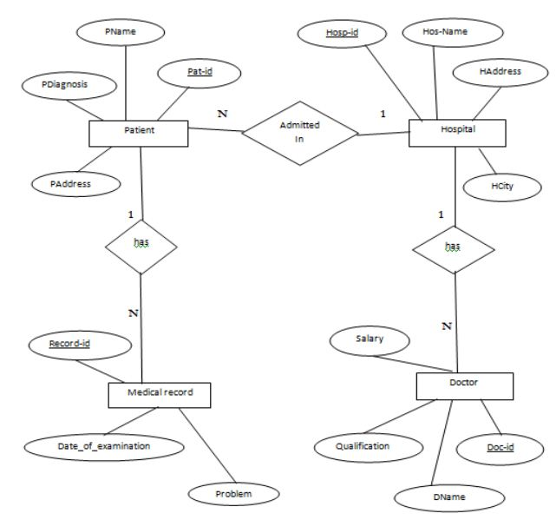
Construct an ER Diagram for hospital with a set of patients and set of medical doctors. Associate with each patient a log of various tests examinations conducted

Slide 20
Thanks………..

